Slide 1
WELCOME
Dr. J A M Azizul Haque
Lecturer in Biology (Botany)
Saturia Syed Kalu Shah College
Saturia, Manikganj.
azizulhe@gmail.com
Web: www.azizulhaque.webs.com
Mob: 01715 322 380
Biology 1st Paper
Class XI, Chapter II
Nucleic Acid
Duration of class 45.00M.

Slide 2
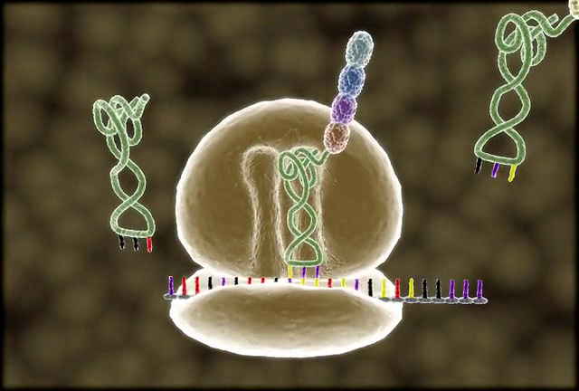


Slide 3
How DNA works?

Slide 4
Learning outcome
At the end of this class students ---
a) Can speak the definition of ‘transformation’
and ‘translation’.
b) Can describe codon and anticodon.
c) Can explain protein synthesis from ribosome
provided information from mRNA by DNA.

Slide 5
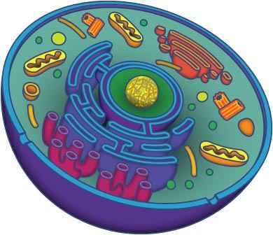
RIBOSOME
Ribosome
40S
60S
Ribosome in the cell
80S Ribosome

Slide 6
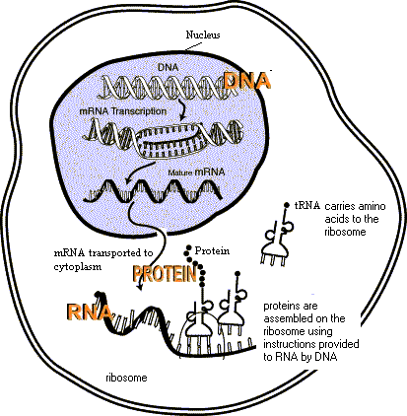
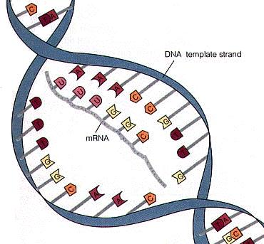
Transcription
DNA template
Nucleus
mRNA
mRNA
Animal cell

Slide 7
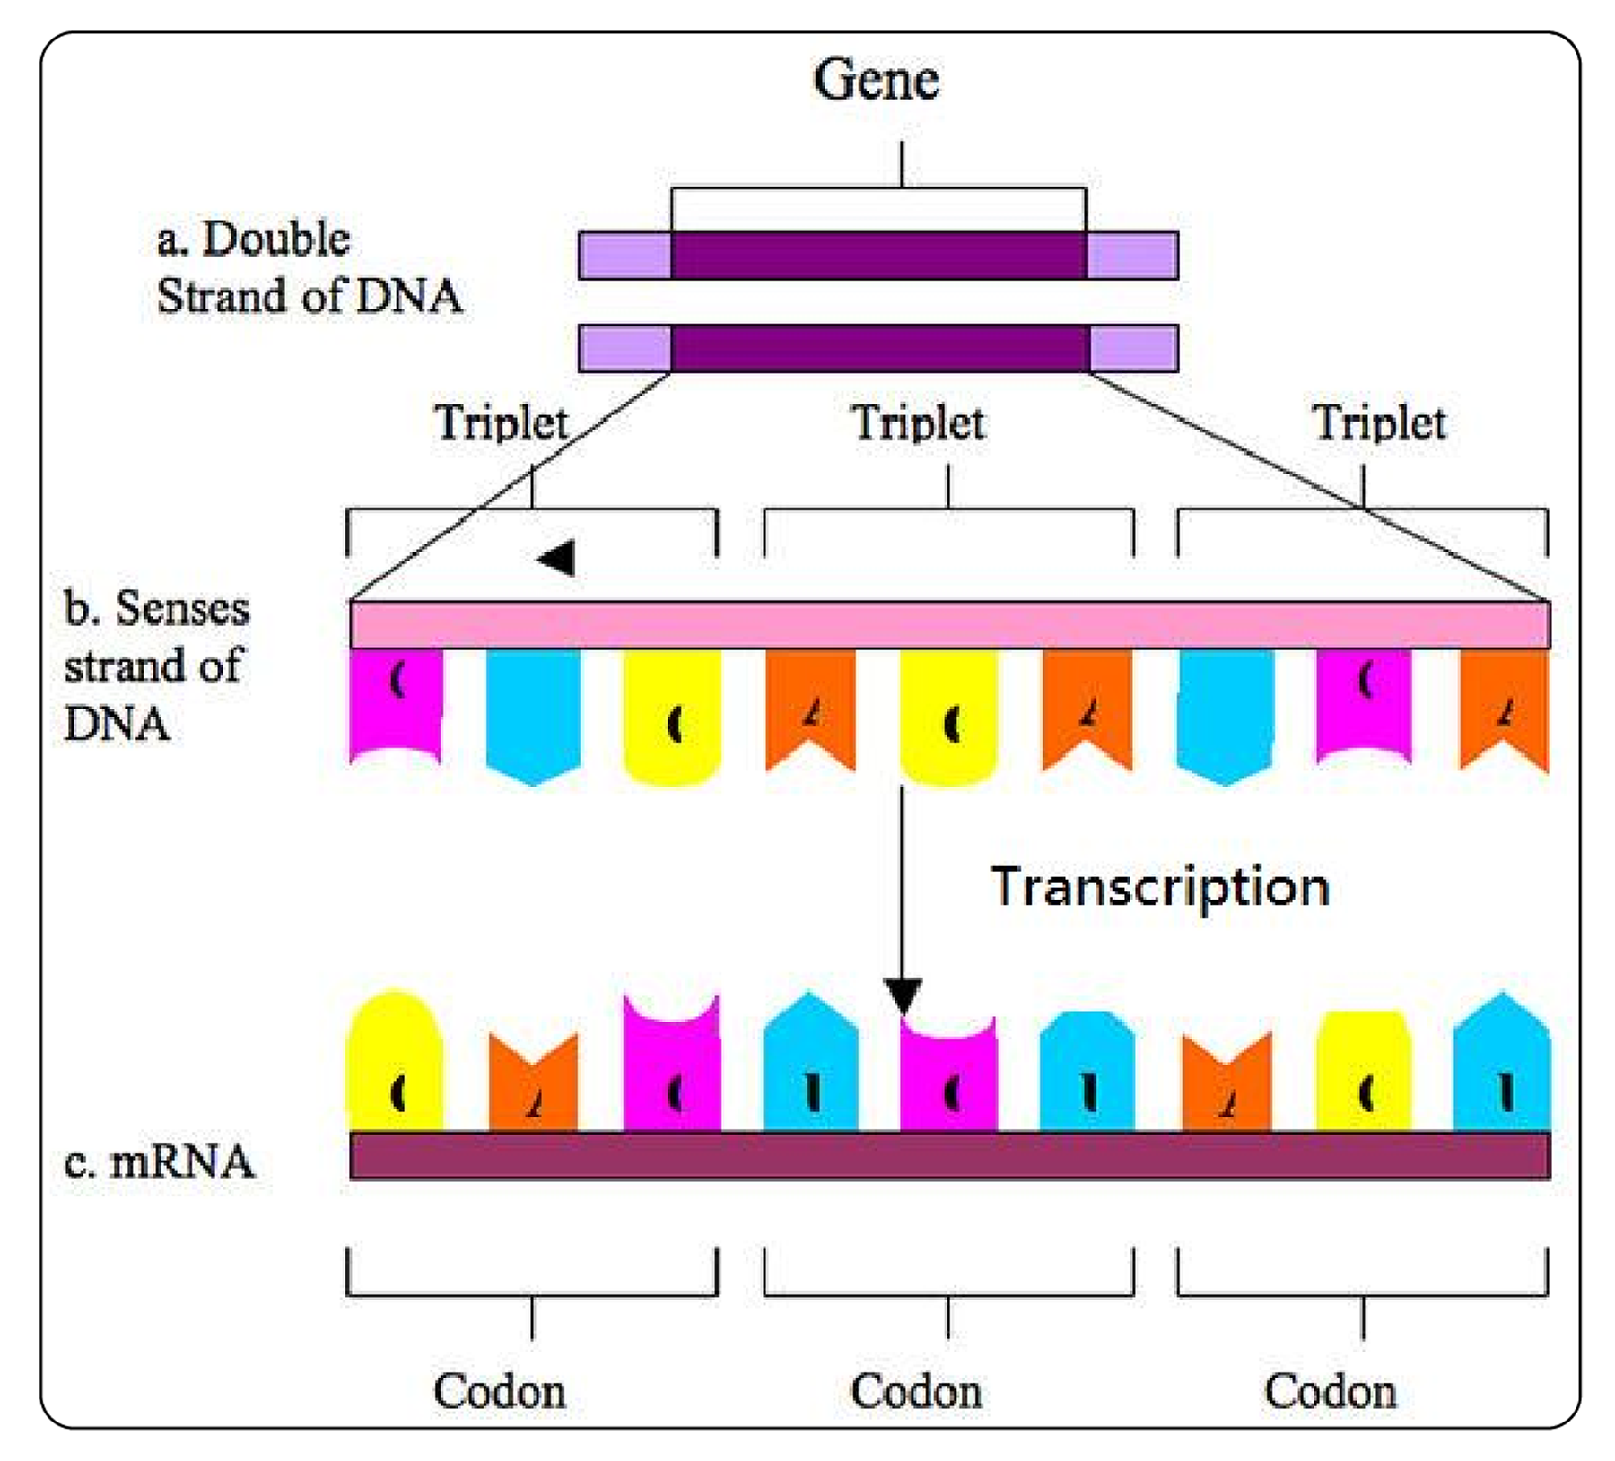
Triplet and Codon
A
G
T
C
T
C
G
A
C
U
A
G
A
G
U
G
C
C

Slide 8
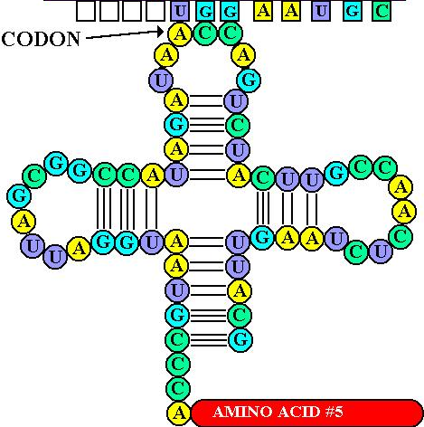
tRNA and Anticodon
mRNA
Anticodon
Amino Acid
tRNA

Slide 9
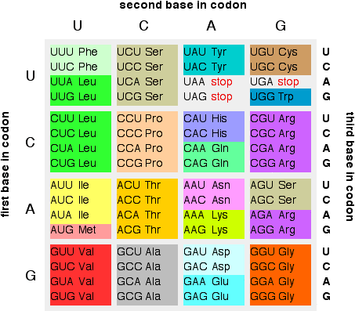
Different codon & respective amino acid

Slide 10
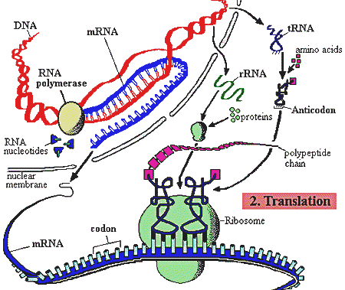
Protein Synthesis
Transcription
Nucleus
Polypeptide chain
Translation
Cytoplasm

Slide 11
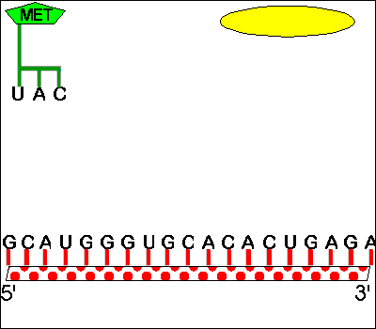

mRNA
Method of Translation

Slide 12
Video
http://ictinedubd.ning.com/video/protein-synthesis
(Need internet connection)

Slide 13
Group Work
A T A G C C A T T G A C C T T A G C
Write codon and anticodon sequence of mRNA and tRNA respectively by using DNA template above.
Time: 10 .00 minutes

Slide 14
Evaluation
a) Where does protein synthesis
take place?
b) What is the difference between
codon and anticodon?
c) Explain the assembly of proteins
by ribosomes?

Slide 15
Assignment
Why is protein synthesis important?

Slide 16

Thanks a lot

